Slide 1
Adaptation in Cloud Computing
Term Project
Rohit Kumar

Slide 2
Sections
Preliminaries
Problem statement
Literature Survey
Preferred approach
My ideas on possible extensions
Key takeaways

Slide 3
Preliminaries

Slide 4
Cloud Elasticity
Cloud Elasticity is defined as
the degree to which a system is able to adapt to workload changes by provisioning and de-provisioning resources in an autonomic manner, such that at each point in time the available resources match the current demand as closely as possible.
SLA With Customers
IaaS
E.g
Software-as-a-Service (SaaS) providers relying on Infrastructure-as-a-Service (IaaS)
have the capability to quickly cope with highly and unpredictable demands by finely allocating resources accordingly
Therefore meeting Service Level Agreements (SLAs) previously established with their customers
SaaS provider

Slide 5
Horizontal elasticity
Basically refers to the on-demand adding of a new VM
Horizontal scaling is applicable for applications that have a clustered architecture.
with a gateway or a master node that distributes requests between the worker nodes (or VMs).
Adding or removing node from cluster is the elastic mechanism.
Cost depends on the ease with which nodes can join or leave the cluster.
We will notate as HS_{Infra} throughout the ppt.

Slide 6
Vertical elasticity
Adding / deleting RAM or CPU to/from VM system.
Modern hypervisors support online VM resizing allowing one to add CPU or memory resources to a VM without bringing it down.
Note 1: vertical scaling is limited by the amount of free CPU cores and memory available on the physical server hosting the virtual machine.
Note 2: Modern hypervisors also support live migration allowing virtual machines to be migrated from one physical server to another.
We will notate as VS_{Infra} throughout the ppt.

Slide 7
Software elasticity
Software Elasticity is the capability of a software to adapt itself (ideally in an autonomic manner) to meet
demand changes
and/or
infrastructure resources limitations
We will notate as HS_{Soft} and VS_{soft} throughout the ppt.
HS_{Soft} - add or remove software components on the fly
VS_{Soft} - change the offering of existing components.

Slide 8
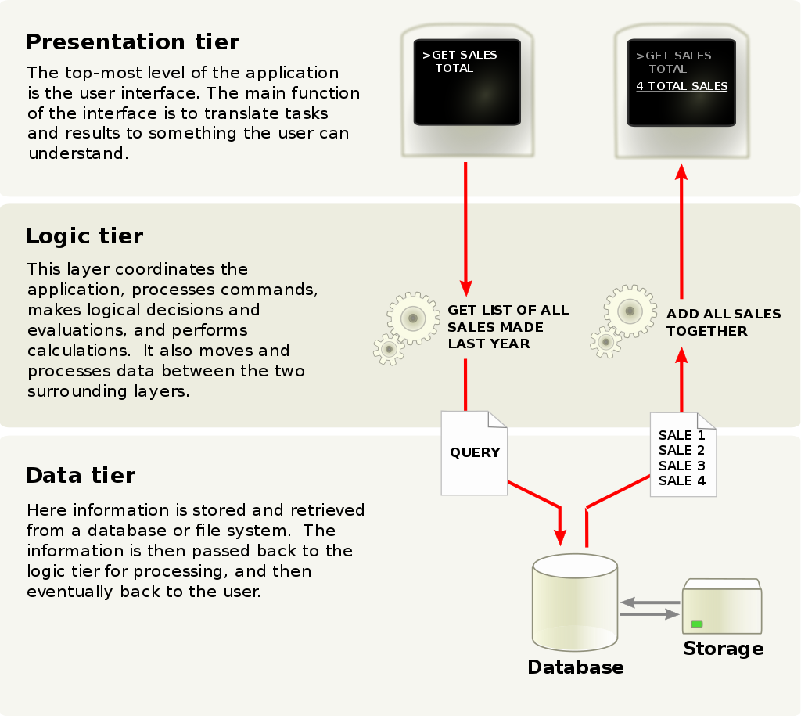
Three layer software model
Modular view of software.
Each unit can be handled in cloud environment in seperate ways.
E.g. Google App Engine can be used only for logic tier/layer and Amazon Database service for data layer for the same software.
Image source : Wikipedia

Slide 9
Difference b/w Elasticity mode and Method

Slide 10
Elasticity mode
Mode (policy) refers to the needed interactions (or manner) in order to perform elasticity actions
It handles the case of how the need for adaptation is calculated.
Reactive mode
Static threshold
Dynamic threshold
Proactive mode
Time series analysis:
Model solving mechanisms
Model predictive control (MPC)
Reinforcement Learning (RL)
Control theory

Slide 11
Elasticity Methods
Once elasticity policy have decided for more resources, elasticity methods handles how the demanded resource will be provided.
To deploy the elasticity solutions, one or hybrid of the following methods is implemented to meet the demand.
Infrastructure
Horizontal scaling
Vertical scaling
Software level
Software Elasticity

Slide 12
Problem Statement

Slide 13
Cloud Computing
The cloud supports online provisioning / deprovisioning of resources provides a flexible system of resources for the softwares.
It helps in robust handling of dynamic traffic that service provider face from day to day.

Slide 14
Problem Statement
The problem is to select one of the possible method such that it is optimal.
Optimal in the sense that it satisfies over the following recognised challenges
Resources are limited
Resource initiation time can be too long.
Partial usage waste.
Current State
VS_{Soft}
HS_{Infra}
VS_{Infra}
HS_{Soft}

Slide 15
Literature Survey

Slide 16
Papers Reviewed
How to Adapt Applications for the Cloud Environment
Presents a review of field.
Three layer software development model as base and studies the adaptation layerwise.
Data layer
Business layer
Presentation layer
Addresses the research questions and open challenges with respect to adaptation of each layer.

Slide 17
Papers Reviewed
SmartScale: Automatic Application Scaling in Enterprise Clouds
Summary :
Addresses the choice of horizontal scaling and vertical scaling as an optimisation problem
Optimisation to minimize the joint cost of horizontal scaling and vertical scaling
Uses binary search to find the minima.

Slide 18
Papers Reviewed
SmartScale: Automatic Application Scaling in Enterprise Clouds
Issues not recognised :
Resource initiation time - what if vertical and horizontal scaling initiation time is high ?

Slide 19
Papers Reviewed
Experimental Analysis on Autonomic Strategies for Cloud Elasticity
Addresses the various challenges in cloud computing adaptation
Resource limitation, initiation time, partial usage wastage.
E.g consider the case that there is peak demand of resources for minutes but initiation time is in of the order of minutes.
Think of the implications.
Addresses a new adaptation that could help with the high initiation time
Software elasticity
Uses MAPE-K loop.

Slide 20
Papers Reviewed : Experimental Analysis on Autonomic Strategies for Cloud Elasticity
There are two types of resources at our hand to use for adaptation
Infrastructure and Software elasticity
Each of the above have their Horizontal and vertical Components.
HS_{Infra}
VS_{Infra}
HS_{Soft}
VS_{Soft}
Infrastructure resources
are limited. I.e there is a threshold beyond which we can’t extend.
initiation time is significant i.e maybe of the order of minutes.
Pricing is per instance-hour : leads to partial usage wastage
Software resources
Initiation time is negligible compared to infrastructure resources.
Current State
Infrastructure
Software
HS_{Soft}
VS_{Soft}
HS_{Infra}
VS_{Infra}

Slide 21
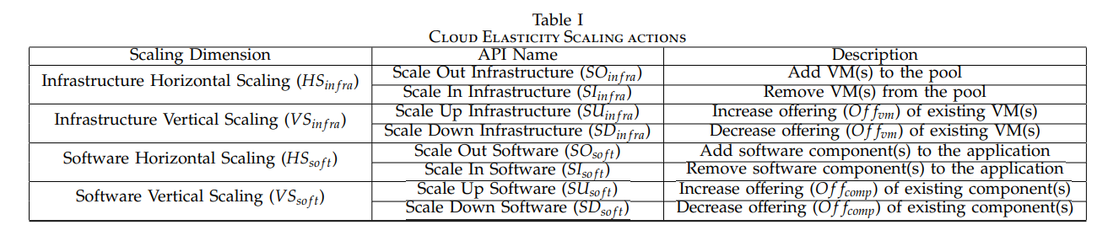
Papers Reviewed : Experimental Analysis on Autonomic Strategies for Cloud Elasticity
Benefits of this complementary usage of IaaS and SaaS elasticities
Alleviate the use of infrastructure resources.
Improve responsiveness of scaling
Improve expression capabilities of elasticity.

Slide 22
Papers Reviewed : Experimental Analysis on Autonomic Strategies for Cloud Elasticity
The model
Autoscaling Service.
Manages the elasticity of resources.
Person Incharge of this - CA : Cloud Administator.
CA needs a way to monitor and act on both Iaas and SaaS resources,

Slide 23
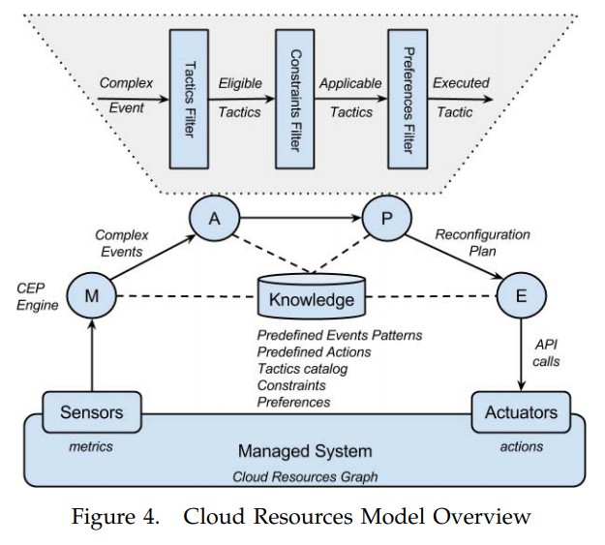
Papers Reviewed : Experimental Analysis on Autonomic Strategies for Cloud Elasticity
The model
B. Model overview

Slide 24
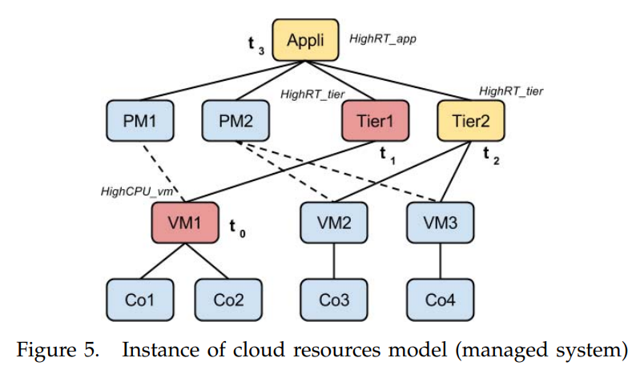
Papers Reviewed : Experimental Analysis on Autonomic Strategies for Cloud Elasticity
C. Managed system
An n-tier web applications
Each tier is hosted on a VM
VM’s are hosted on a set of Physical Machines ( PM )

Slide 25
Papers Reviewed : Experimental Analysis on Autonomic Strategies for Cloud Elasticity
D. Monitor : Events
Each cloud resource has a set of metrics indicating its health.
The monitor phase collect and aggregate multiple sensor values over time.
This helps system to make timely relevant information about the system health in form of events.
An example of event:
if CPU consumption of one VM has exceeded a maximum threshold, generate a HighCPU_vm event.
Events
Complex events are generated by composition of basic event.
Basic
Complex
Event patterns :
to detect complex relationships between events overtime by defining correlation rules also known as Event Patterns.
CA needs to observe and define these.

Slide 26
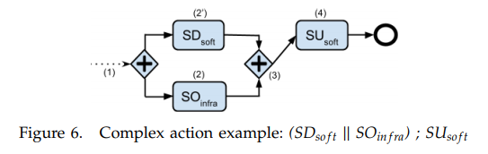
Papers Reviewed : Experimental Analysis on Autonomic Strategies for Cloud Elasticity
E. Execute : predefined actions
Actions : Basic actions and complex actions
The goal of the complex actions is to absorb the infrastructure resource initiation time.
a SD_{soft} (e.g., switching the Offcomp from Video HD to Image - step 2’)
SU_{soft} (e.g., switching back to Video HD - step 4)
SO_{infra} (e.g., adding one VM to the pool - step 2)

Slide 27
Papers Reviewed : Experimental Analysis on Autonomic Strategies for Cloud Elasticity
F: Analyse and Plan : Reconfiguration decision
Tactic filter : A tactic is actually an event-action pair defined by CA and representing a well-known IF-THEN statement.
the Tactics Filter takes a look at the event-action mapping stored in the Knowledge which was given by CA
Lookup in knowledge
Runtime constraints e.g maximum capacity of PM in terms of RAM and CPU
Constraints Filter – Context: The runtime context can induce some constraints that may prevent to execute eligible tactics.
CA preferences
Preferences Filter – Strategy: based on CA preferences, final action to take.
Some criteria: Cost, QoS, QoE, Elasticity time, Responsiveness

Slide 28
Papers Reviewed : Experimental Analysis on Autonomic Strategies for Cloud Elasticity
G: Knowledge
data shared among all MAPE phases such as
current cloud resources graph with associated metrics values,
runtime constraints
preferences expressed on the system.
event patterns and predefined actions
Tactics

Slide 29
Additional Papers
A Survey on Cloud Computing Elasticity - Link
Elasticity in Cloud Computing: What It Is, and What It Is Not - Link
Horizontal and Vertical Scaling of Container-Based Applications Using Reinforcement Learning - Link
Elasticity in Cloud Computing: State of the Art and Research Challenges - Link

Slide 30
Preferred Approach

Slide 31
Smart scale does not take into account the infrastructure resource initiation time.
There have been few work in cross-layered adaptation.
Integrating the SaaS layer elasticity with infrastructure elasticities is one possible approach to handle it.

Slide 32
My ideas on possible extensions

Slide 33
Discussed paper
There is no optimisation in resource selection at runtime.
CA have a quite big role.
He have to decide preferred actions by test runs at different constraints and other factors.
Need of a team to manual handle the optimisation and changing system parameters iteratively.
Smartscale paper proposes one such algorithm that can be used.
The human intervention can be minimised or the decision algorithm can be based on some algorithm that adapts itself with time.
RL

Slide 34
Cross-layered optimisation
The resource initiation time is a physical limit in the cloud systems.
Algorithmically, cross-layered approach to handle the issue seems a valid direction to work towards.
There is not much work in this direction.
One other work is Rainbow
Using RL with human in loop can be a viable solution that
Minimises the human intervention.
Optimises for the resource selection.

Slide 35
Key Takeaways

Slide 36
Cloud paradigm has changed the way we work around now. E.g google drive, onedrive etc.
The change for the softwares is quite huge.
It poses several options and we need to select best for us, as we are paying for the same.
Hence, a need for optimisation in resource selection.
SmartScale - infrastructure layer based only.
Infrastructure resource initiation time is high.
Cross-layered elasticities is one possible solution.

